Slide 1
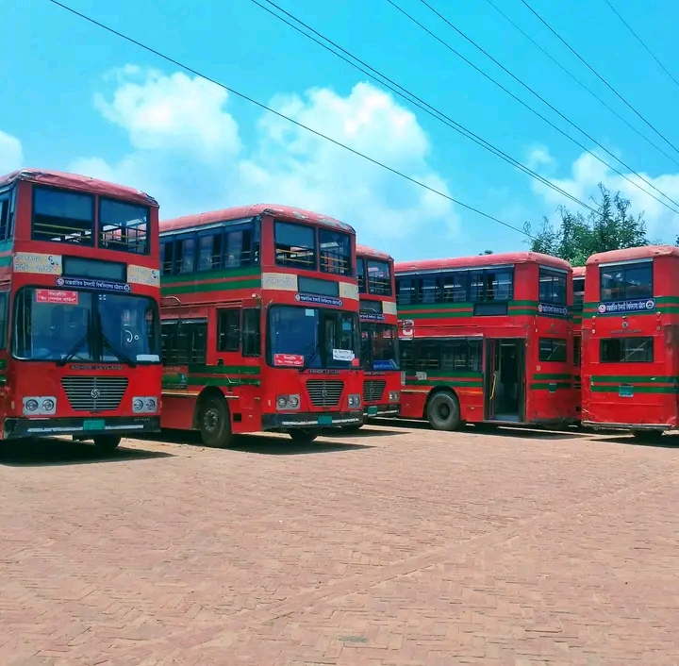
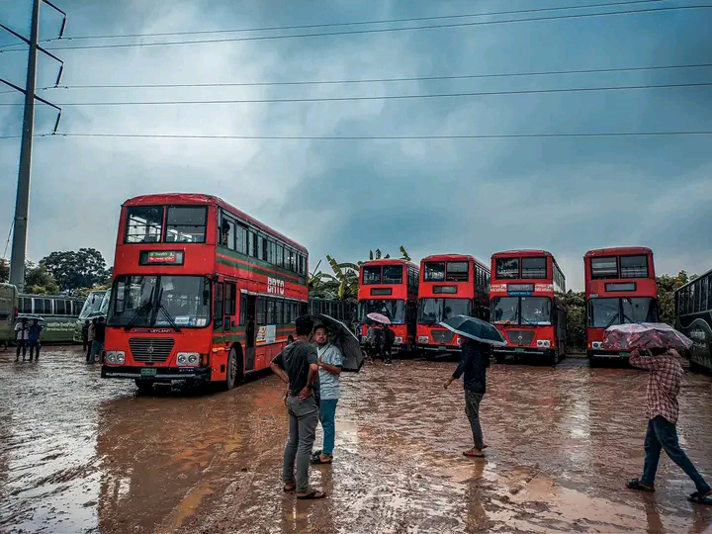
TRANSTECH
IIUC DIGITAL TRANSPORTATION SYSTEM

Slide 2
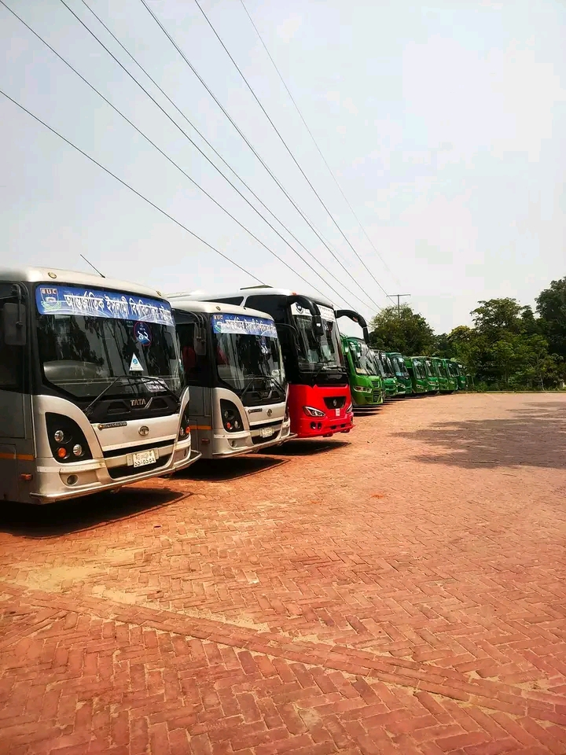
INTRODUCTION
Transtech is a cutting-edge transportation system designed to revolutionize the way we move. Transtech emerges as a solution to address the complex challenges faced by students. Transtech places a strong emphasis on student experience. Transtech employs a transparent and fair approach to seat allocation, ensuring that every student has an equal opportunity to secure seat. Furthermore, Transtech understands the importance of providing students with comprehensive information about bus routes.

Slide 3
Objectives
To improve the transportation system for both students and teachers, ensuring a smoother experience.
To remove the problem of extra seat reservation.
To lessen the hassle and ensuring seats for all students as well as teachers.
To update students as soon as possible about the buses and routes.
To digitalize the process which saves lots of time as well.

Slide 4
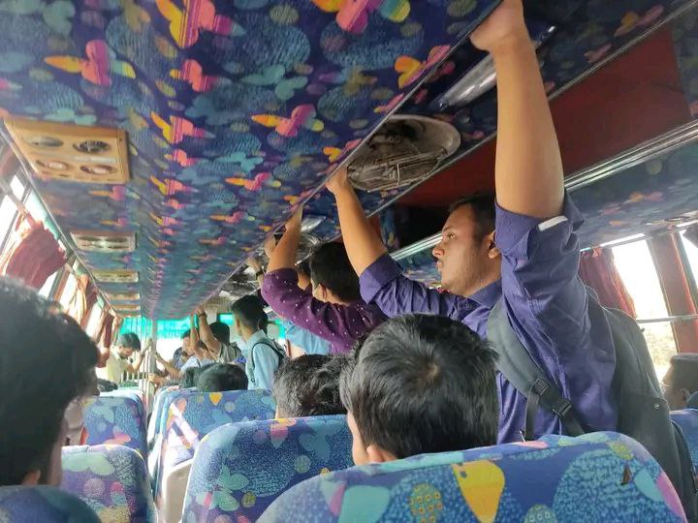
PROBLEM STATEMENT
During peak hours, buses or shuttles may become overcrowded, leading to discomfort for students. Additionally, delays in the transportation system, can cause inconvenience and may result in students arriving late to their classes. Again, officials may not know how many buses will be needed as they don’t know what number of students are waiting for buses. Then, students may not get the update of installing extra buses in particular routes, cause in offline, it’s difficult to inform mass students. Again, students rush for a seat in extra buses which create a lot of chaos.

Slide 5
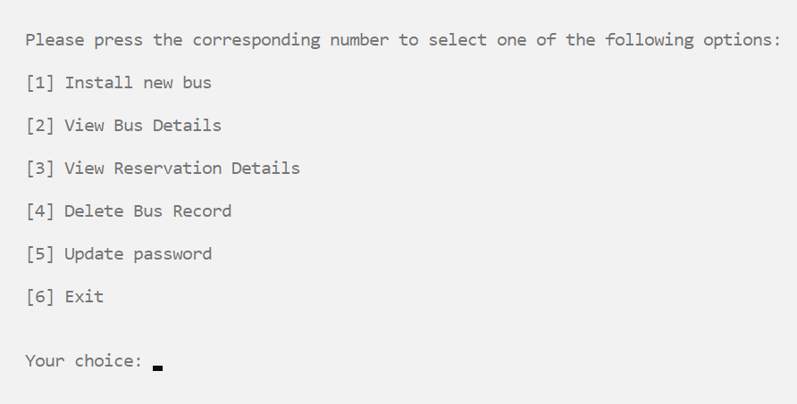
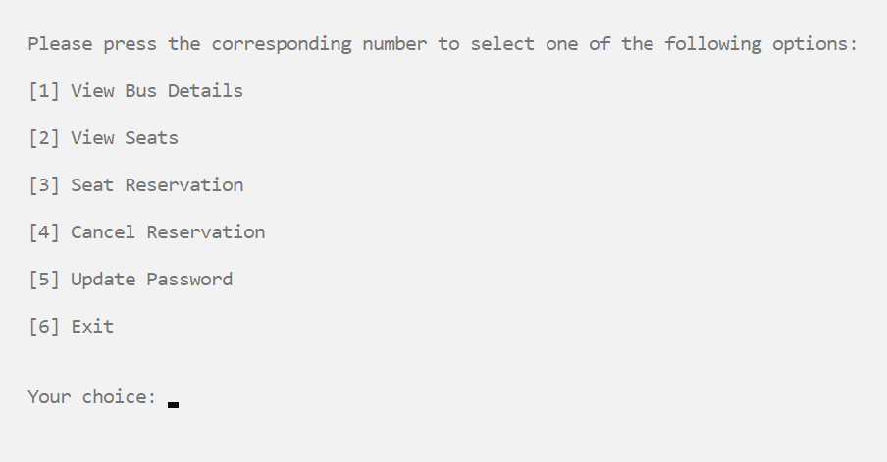
MODULES
PORTAL
Transtech offers two distinct portals: the Admin portal and the User portal. Access to the Admin portal, which holds sensitive administrative functions, requires the exclusive use of the admin's unique username and password, ensuring that only authorized personnel can gain entry.

Slide 6
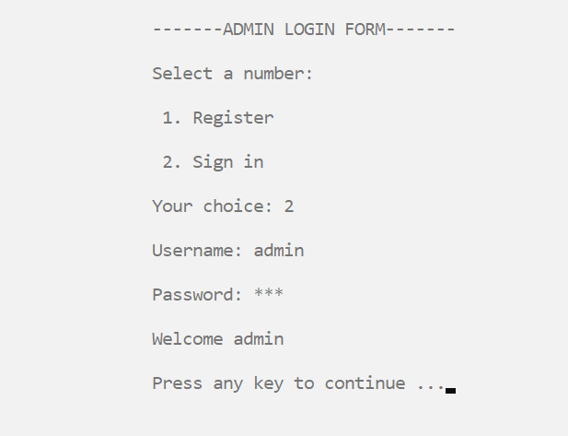
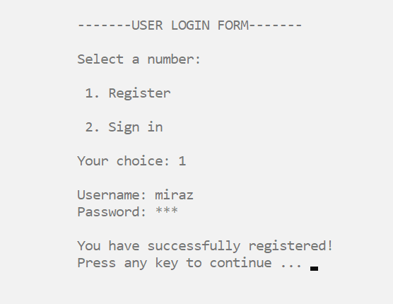
MODULES
LOG IN
The system will provide a login feature to ensure secure access for authorized users. The admin , students and teachers need to register with a username and password. Users will have the ability to set a new password in case they need to update their login credentials

Slide 7
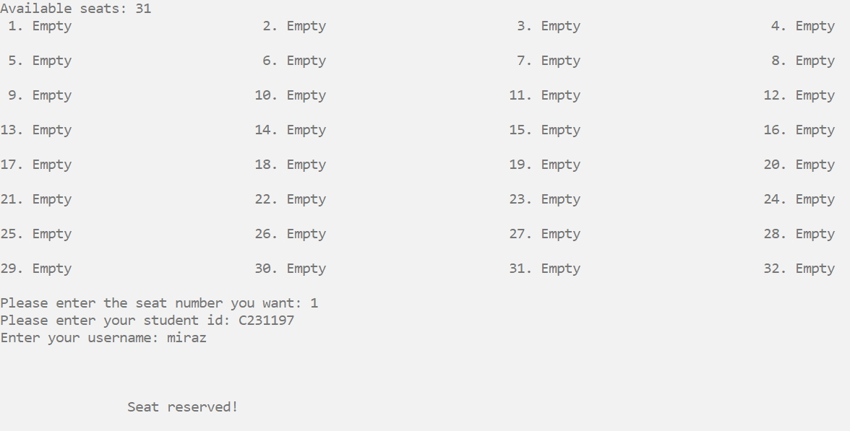
MODULES
SEAT RESERVATION
The system will allow students and teachers to reserve seats using id and username on available buses specifying the date, time and destination for their transportation needs.

Slide 8
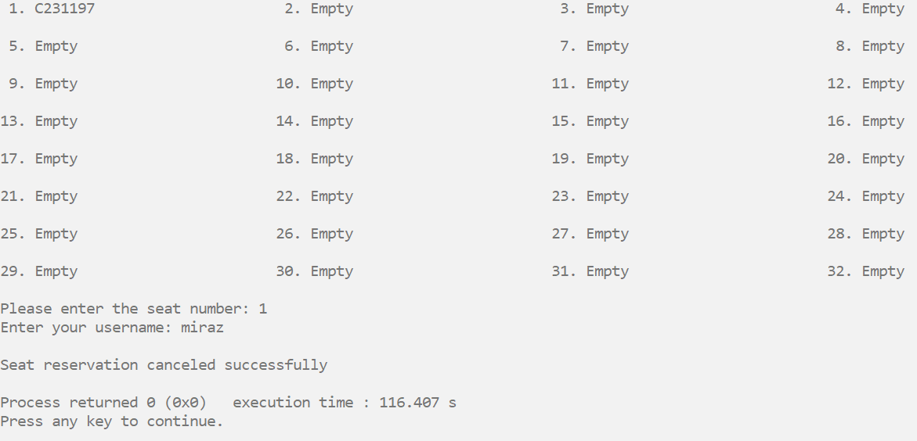
MODULES
SEAT CANCELLATION
The user will have the ability to easily cancel seat reservations as needed. Students and teachers need to use the username while cancelling the seat. Only if the username matches, one can cancel the reservation.

Slide 9
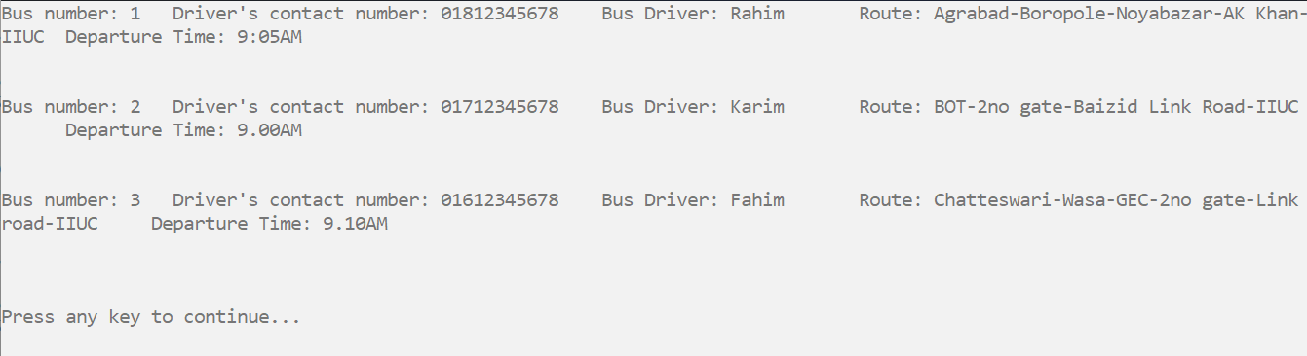
MODULES
BUS SCHEDULE
Admin and students will be able to view the existing buses in the system, including their details and availability for transportation services.

Slide 10
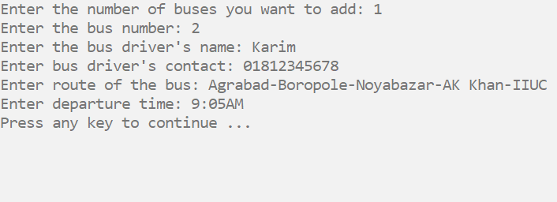
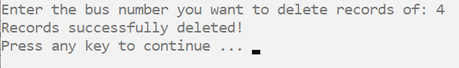
MODULES
ADD BUSES
The system will include functionality to add new buses to the transportation fleet, including specifying details such as bus number, capacity and other relevant information.
DELETE BUSES
Admin will have the option to delete a bus from the system if it is no longer in service or has been replaced.

Slide 11
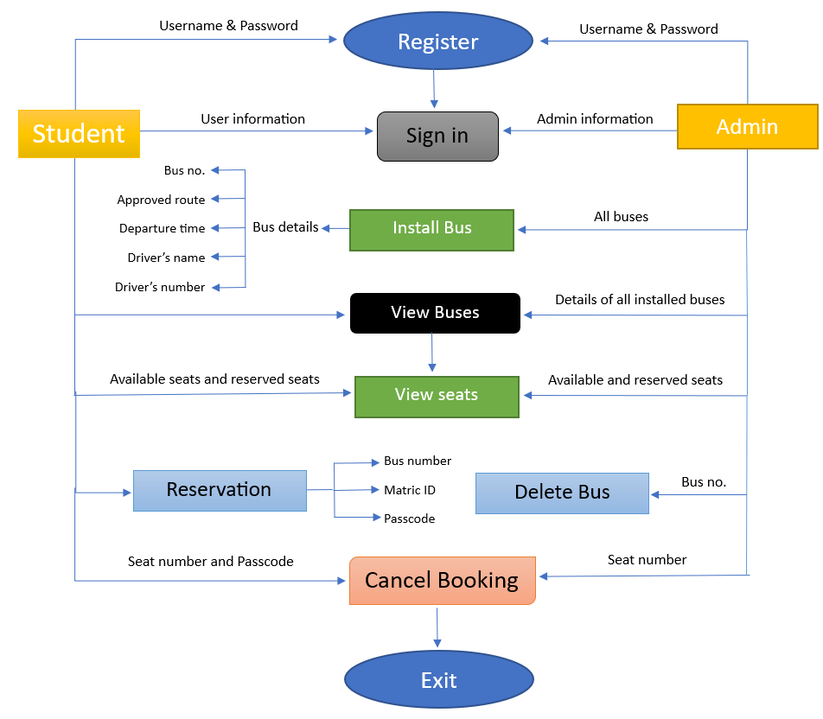
DATA FLOW DIAGRAM

Slide 12
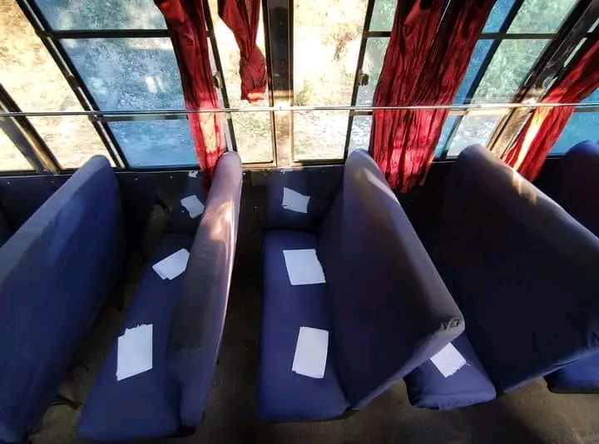
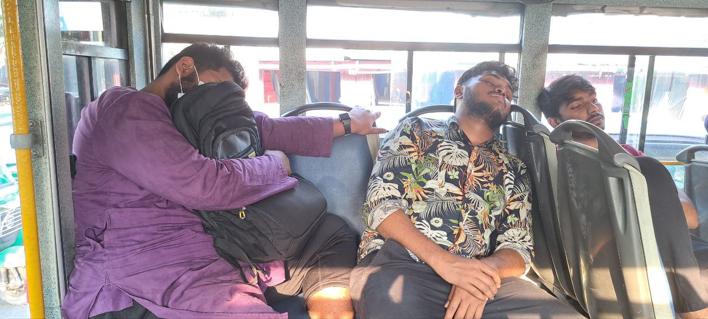
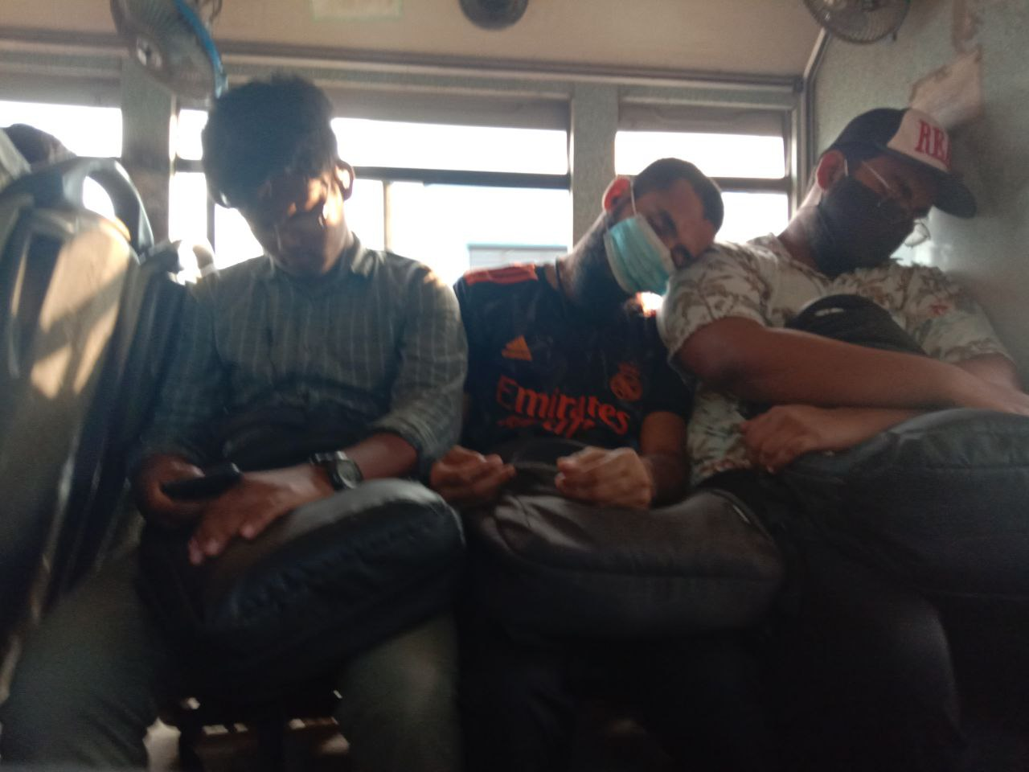
Thank You!
BEFORE
Presented by:
Md. Mohiul Islam Miraz-C231197
Kazi Md. Safayat Khan-C231181
Mohammed Shifath-C231198
AFTER

